Slide 1
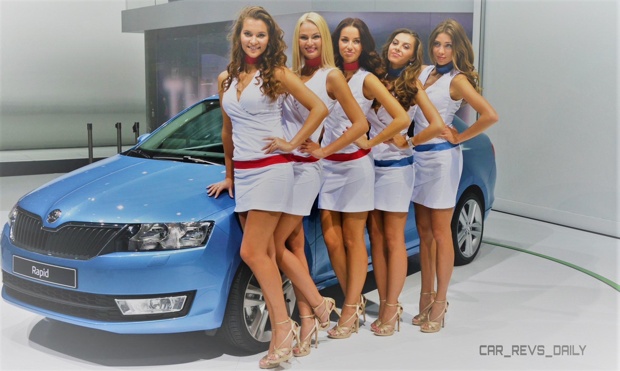
Car Sales EDA

Slide 2
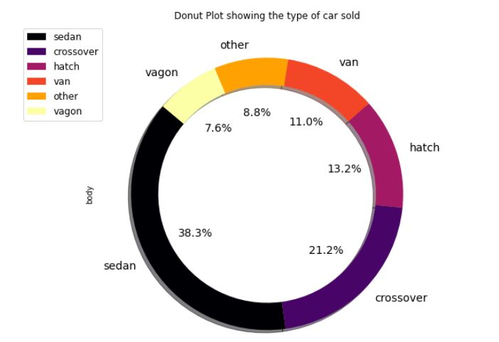
Type of Cars sold in the given time duration : Body Type
Sedan is the most sold car type and Vagon is the least sold.
Crossover is the second most sold car type.

Slide 3
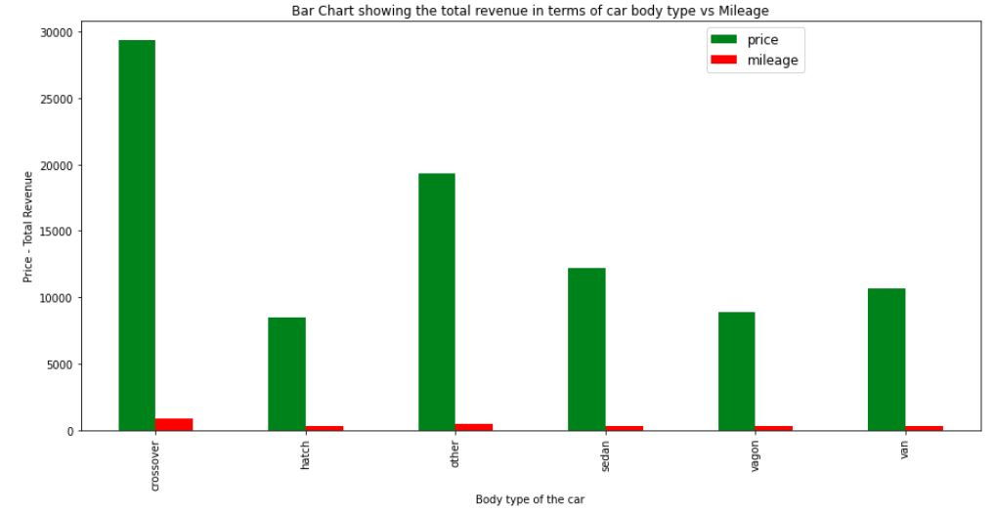
Total revenue & Mileage in terms of Car body type: Mean value
Crossover body type brought more revenue to the company.
Other type comes second.
Also crossover cars provided better mileage when compared to others.

Slide 4
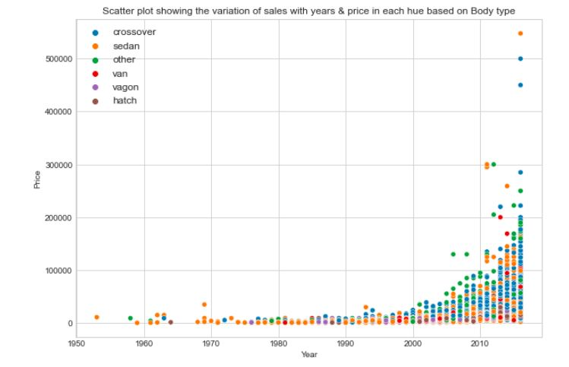
Body type sold in scatter:
Diesel & other type brought more revenue to the company.
Diesel & other type provides better mileage.(Other type can be hybrid or electric vehicle)

Slide 5
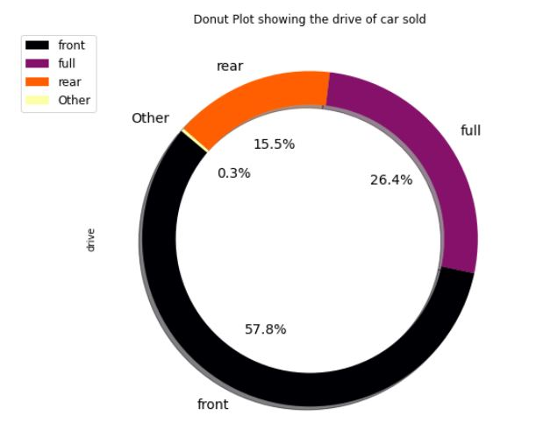
Type of car drive sold in the given time duration :
Front car drive is the most sold car type and other car drive type is the least sold.
Full drive is the second most sold car type.

Slide 6
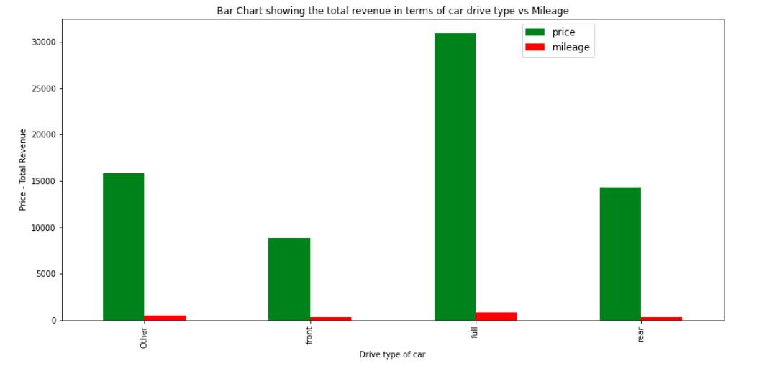
Total revenue in terms of Car drive type: Mean value
Full drive type brought more revenue to the company.
Full drive type also provided better mileage.

Slide 7
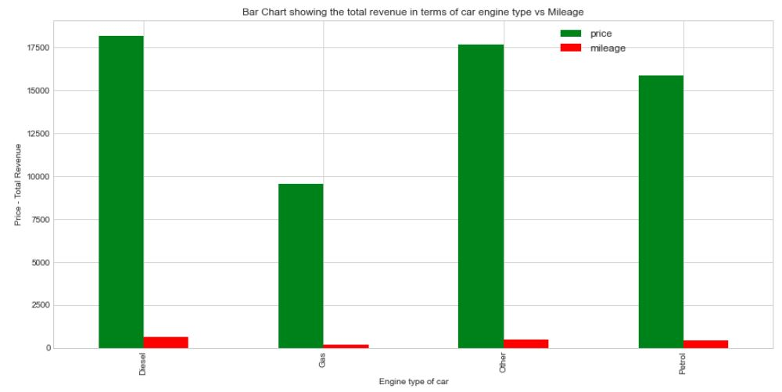
Total revenue in terms of Car engine type: Mean value
Diesel & other type brought more revenue to the company.
Diesel & other type provides better mileage.(Other type can be hybrid or electric vehicle)

Slide 8
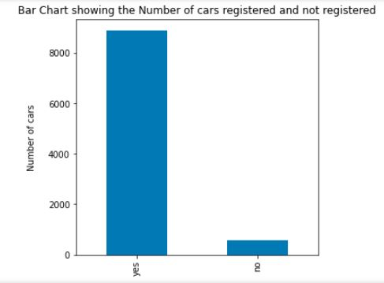
Car Registration Done:
Majority of the cars sold during given time period were registered except
very few number

Slide 9
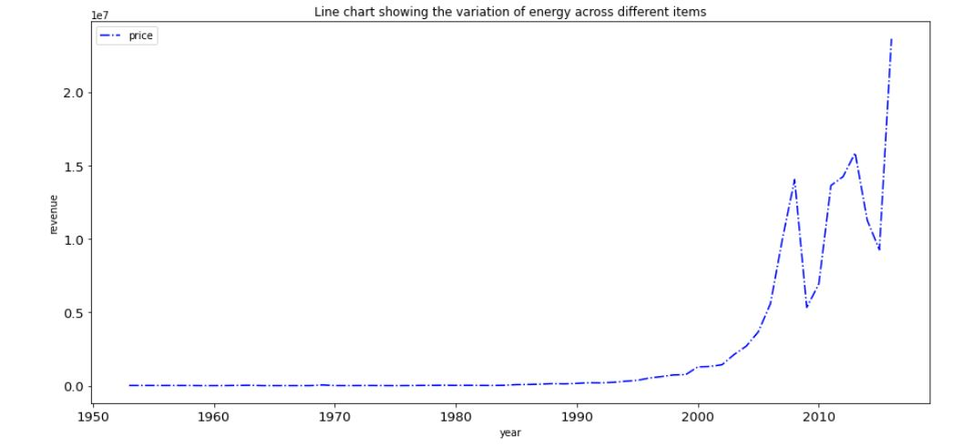
Revenue Trend:
The revenue started increasing from the year 1995 and had fell in 2010 and again
regained its momentum from 2010 and the revenue increased.

Slide 10
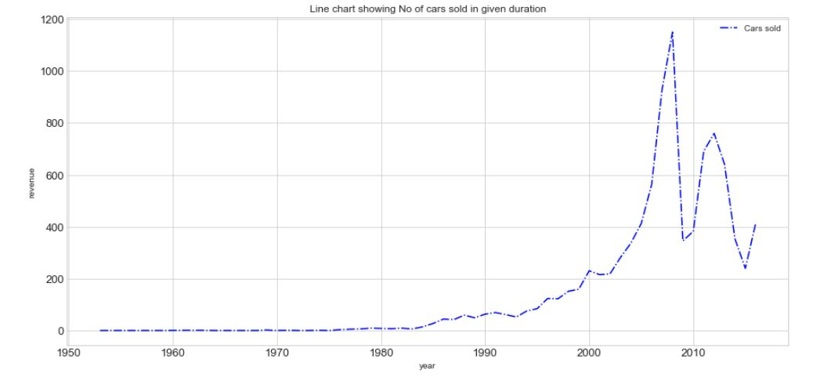
Car Sale Trend:
The Car sales trend started increasing from the year 1995 and had fell in 2010 and again
regained its momentum from 2010.

Slide 11
Insights:
In the given duration sedan & crossover sold the most and it might be peoples preference when it comes to style.
Crossover type brought more revenue to the company and the same time crossover provides better mileage. It might be the mileage factor which attracts more sale.
Crossover and sedan grows over the time and even in future more customer may tend to buy the same.
Front car drive is the most sold car type but when it comes to revenue perspective, full drive brought in more revenue and at the same full drive provides better mileage.
Diesel & other engine type brought major revenue to company and it also provides better mileage.
Majority of the cars sold during given time period were registered except
very few number
The sales started increasing from the year 2000 and thus increase in revenue. Due to economic development and need for transportation vehicle / car the trend will keep increasing.

Slide 12
Action Item:
Based on the insights the company can :
Focus / invest more on selling vehicles which is Crossover model which has got Full drive with diesel engine or other engine type.
Focus / invest more on selling vehicles which is sedan model which has got Full drive with diesel engine or other engine type.
Explore on other type engine and this can be electric or hybrid.

